Slide 1
Adventureworks power bi project
Shaikha Aldoseri
Ali Ahmed Ali

Slide 2
What is adventureworks?
Fictional company specializing in manufacturing bicycles
Sells accessories and clothing in addition to bicycles
Global presence, notably in USA and Europe
Business model: online store and salespeople to pitch sales

Slide 3
PROBLEM STATEMENT
How to recover from our company's losses in 2014?
OBJECTIVES
What is the total revenue? What is our total loss?
What is the total of quantity sold?
Which product subcategories is sold the least? Which is least profitable?
Which location is least profitable?
How much did we lose in profits per month?
How many salespeople didn't meet their quota?

Slide 4
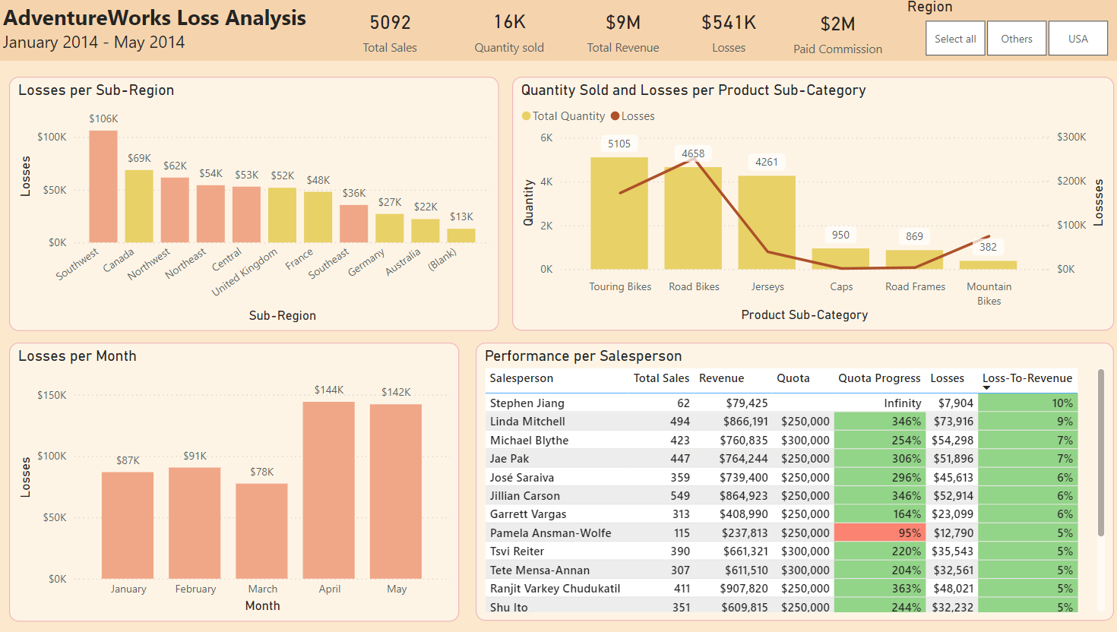
Snapshot of THE dashboard

Slide 5
Consider a new business strategy for mountain bikes.
Improve marketing for jerseys in Southwest, USA.
Consider market expansion to Australia, Germany and Southeast.
RECCOMENDATIONS

